Slide 1

ME 322: Machine Design
Rolling Contact Bearings
Prof. S. K. Kakoty

Slide 2
Bearings
Bearing is a mechanical element that permits relative motion between two parts, such as the shaft and the housing, with minimum friction.
The functions of the bearing are as follows:
The bearing ensures free rotation of the shaft or the axle with minimum friction.
It supports the shaft or the axle and holds it in the correct position.
It takes up the forces that act on the shaft or the axle and transmits them to the frame or the foundation.

Slide 3
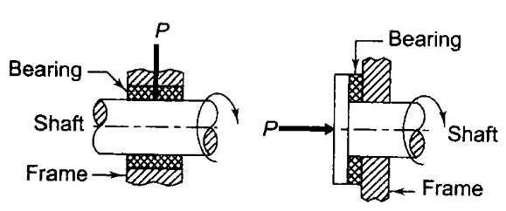
Classification of bearings
Depending on the direction of acting of load, bearings are classified in to two types.
Radial bearings
Thrust bearings
Radial bearings supports the load which acts perpendicular to the axis of the shaft where thrust bearings support the load acting along the axis of the shaft.
Fig.1: (a) Radial bearing (b) Thrust bearing

Slide 4
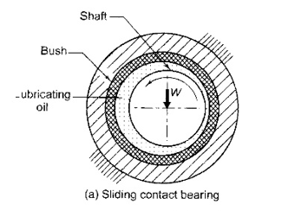
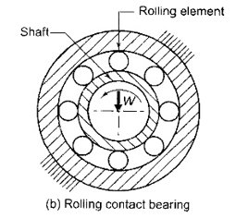
Depending on the type of friction, bearings are classified in to two groups.
Sliding contact bearings
Rolling contact bearings
Fig. 2: Classification of bearings

Slide 5
Sliding contact bearings
In Sliding contact bearings, the surface of the shaft slides over the surface of the bush resulting in friction and wear.
In order to reduce the friction, these two surfaces are separated by film of lubricating oil.
The bush is made of special bearing material like white metal or bronze.
Sliding contact bearings are also called plain bearings, journal bearings or sleeve bearings.
Some applications of Sliding contact bearings are:
crankshaft bearings in petrol and diesel engines
centrifugal pumps
large size electric motors
steam and gas turbines
concrete mixers, rope conveyors and marine installations.

Slide 6
Rolling contact bearings
In Rolling contact bearings, rolling elements such as balls or rollers are introduced between the surfaces that are in relative motion.
In this type of bearings sliding friction is replaced by rolling friction.
Rolling contact bearings are also called anti-friction bearings or simply ball bearings.
Some applications of Rolling contact bearings are:
machine tool spindles
automobile front and rear axles
gear boxes
small size electric motors
rope sheaves, crane hooks and drums

Slide 7
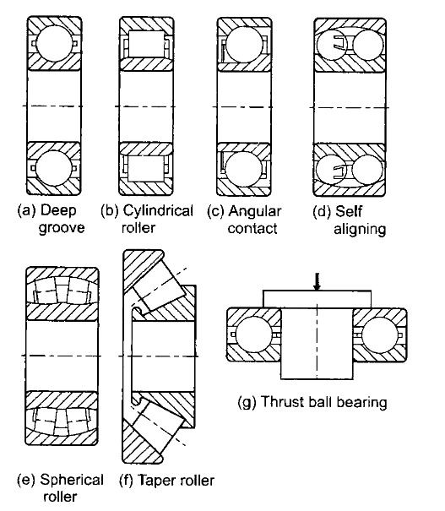
Types of Rolling contact bearings
Deep groove ball bearing
Cylindrical roller bearing
Angular contact bearing
Self-aligning bearing
Tapper roller bearing
Thrust ball bearing
Fig. 3: Rolling contact bearings

Slide 8
Deep groove ball bearing
Deep groove bearing is the most frequently used bearing which is found in almost all kind of products in mechanical engineering.
In this type of bearing, the radius of the ball is slightly less than the radii of curvature of the grooves in the races. Kinematically, this gives a point contact between the balls and the races. Therefore, the balls and the races may roll freely without any sliding.
The advantages of the deep groove ball bearing are
Due to relatively large size of the balls, this bearing has high load carrying capacity.
It takes loads in the radial as well as axial direction.
Due to point contact between the balls and races, frictional loss and the resultant temperature rise is less in this bearing. The maximum permissible speed of the shaft depends upon the temperature rise of the bearing. Therefore, deep groove ball bearing gives excellent performance, especially in high speed applications.

Slide 9
Deep groove ball bearing generates less noise due to point contact.
Deep groove ball bearings are available with bore diameters from a few millimetres to 400 millimetres.
The disadvantages of deep groove ball bearing are:
Deep groove ball bearing is not self-aligning. It requires accurate alignment between axis of the shaft and the housing bore.
Deep groove ball bearing has poor rigidity compared with roller bearing. This is due to the point contact compared with the line contact in case of roller bearing. It is unsuitable for machine tool spindles where rigidity is important consideration.

Slide 10
Cylindrical roller bearing
When maximum load carrying capacity is required in a given space, the point contact in ball bearing is replaced by the line contact of roller bearing.
A cylindrical roller bearing consists of relatively short rollers that are positioned and guided by the cage.
The advantages of Cylindrical roller bearing are:
Due to line contact between rollers and races, the radial load carrying capacity of the cylindrical roller bearing is very high.
Cylindrical roller bearing is more rigid than ball bearing.
The coefficient of friction is low and frictional loss is less in high-speed applications.

Slide 11
The disadvantages of cylindrical roller bearings are:
In general, cylindrical roller bearing cannot take thrust load.
Cylindrical roller bearing is not self-aligning. It cannot tolerate misalignment. It needs precise alignment between axes of the shaft and the bore of the housing.
Cylindrical roller bearing generates more noise.

Slide 12
Angular contact bearing
In angular contact bearing, the grooves in inner and outer races are so shaped that the line of reaction at the contact between balls and races makes an angle with the axis of the bearing.
This reaction has two components—radial and axial.
Therefore, angular contact bearing can take radial and thrust loads.
Angular contact bearings are often used in pairs, either side by side or at the opposite ends of the shaft, in order to take the thrust load in both directions.
These bearings are assembled with a specific magnitude of pre-load.

Slide 13
The advantages of angular contact bearing are
Angular contact bearing can take both radial and thrust loads.
In angular contact bearing, one side of the groove in the outer race is cut away to permit the insertion of larger number of balls than that of deep groove ball bearing. This permits the bearing to carry relatively large axial and radial loads. Therefore, the load carrying capacity of angular contact bearing is more than that of deep groove ball bearing.
The disadvantages of angular contact bearing are:
Two bearings are required to take thrust load in both directions.
The angular contact bearing must be mounted without axial play.
The angular contact bearing requires initial Pre-loading .

Slide 14
Self aligning bearing
There are two types of self aligning rolling contact bearings
Self aligning ball bearing
Spherical roller bearing
In self aligning ball bearing, the assembly of the shaft, the inner race and the balls with cage can freely roll and adjust itself to the angular misalignment of the shaft.
Compared with the self aligning ball bearing, the spherical roller bearing can carry relatively high radial and thrust loads.
Both types of self-aligning bearing permit minor angular misalignment of the shaft relative to the housing. They are therefore particularly suitable for applications where misalignment can arise due to errors in mounting or due to deflection of the shaft.
They are used in agricultural machinery, ventilators, and railway axle-boxes.

Slide 15
Tapper roller bearing
The taper roller bearing consists of rolling elements in the form of a frustum of cone.
They are arranged in such a way that the axes of individual rolling elements intersect in a common apex point on the axis of the bearing.
In taper roller bearing, the line of resultant reaction through the rolling elements makes an angle with the axis of the bearing.
Therefore, taper roller bearing can carry both radial and axial loads. In fact, the presence of either component results in the other, acting on the bearing.
In other words, a taper roller bearing subjected to pure radial load induces a thrust component and vice versa. Therefore, taper roller bearings are always used in pairs to balance the thrust component.
Taper roller bearing has separable construction. The outer ring is called `cup' and the Inner ring is called 'cone'. The cup is separable from the remainder assembly of the bearing elements including the rollers, cage and the cone.

Slide 16
The advantages of Tapper roller bearings are
Taper roller bearing can take heavy radial and thrust loads.
Taper roller bearing has more rigidity.
Taper roller bearing can be easily assembled and disassembled due to separable parts.
The disadvantages of Tapper roller bearings are
It is necessary to use two taper roller bearings on the shaft to balance the axial force.
It is necessary to adjust the axial position of the bearing with pre-load. It is essential to coincide the apex of the cone with the common apex of the rolling elements.
Taper roller bearing cannot tolerate misalignment between the axes of the shaft and the housing bore.
Taper roller bearings are costly.
Taper roller bearings are used for cars and trucks, propeller shafts and differentials, railroad axle-boxes and as large size bearings in rolling mills

Slide 17
Thrust ball bearing
A thrust ball bearing consists of a row of balls running between two rings-the shaft ring and the housing ring.
Thrust ball bearing carries thrust load in only one direction and cannot carry any radial load.
The major advantage of thrust bearing is:
The use of a large number of balls results in high thrust load carrying capacity in smaller space.
The disadvantages of thrust bearings are as follows:
Thrust ball bearing cannot take radial load.
It is not self-aligning and cannot tolerate misalignment.

Slide 18
Their performance is satisfactory at low and medium speeds. At high speeds, such bearings give poor service because the balls are subjected to centrifugal forces and gyroscopic couple.
Thrust ball bearings do not operate as well on horizontal shafts as they do on vertical shafts.
Thrust ball bearing requires continuous pressure applied by springs to hold the rings together.
Thrust ball bearings are used where heavy thrust loads are to be carried, for example, worm gear boxes and crane hooks.

Slide 19
Specific materials for the Rolling contact bearings
The balls, the inner and outer races are made of high carbon chromium steel (SAE 52100 or AISI 5210). It contains 1 percent of carbon and 1.5 percent of chromium. The balls and races are through-hardened to obtain a minimum hardness of 58 Rockwell C.
The cages are made from stampings of low carbon steel.
The rollers are made of case hardened steels (AISI 3310, 4620 or 8620). They are case carburized to obtain a surface hardness of 58 Rockwell C.

Slide 20
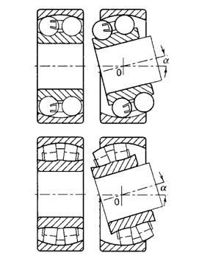
Principle of Self-aligning bearing
Fig. 4: self-aligning bearing

Slide 21
Selection of bearing-Type
For low and medium radial loads, ball bearings are used, whereas for heavy loads and large shaft diameters, roller bearings are selected.
Self-aligning ball bearings and spherical roller bearings are used in applications where a misalignment between the axes of the shaft and housing is likely to exist.
Thrust ball bearings are used for medium thrust loads whereas for heavy thrust loads, cylindrical roller thrust bearings are recommended. Double acting thrust bearings can carry the thrust load in either direction.
Deep groove ball bearings, angular contact bearings and spherical roller bearings are suitable in applications where the load acting on the bearing consists of two components—radial and thrust.

Slide 22
The maximum permissible speed of the shaft depends upon the temperature rise in the bearing. For high speed applications, deep groove ball bearings, angular contact bearings and cylindrical roller bearings are recommended.
Rigidity controls the selection of bearings in certain applications like machine tool spindles. Double row cylindrical roller bearings or taper roller bearings are used under these conditions. The line of contact in these bearings, as compared with the point of contact in ball bearings, improves the rigidity of the system.
Noise becomes the criterion of selection in applications like household appliances. For such applications, deep groove ball bearings are recommended.

Slide 23
Static load carrying capacity
The static load carrying capacity of a bearing is defined as the static load which corresponds to a total permanent deformation of balls and races, at the most heavily stressed point of contact, equal to 0.0001 of the ball diameter.
Static load is defined as the load acting on the bearing when the shaft is stationary.
Formulae are given in standards for calculating the static load carrying capacity of different types of bearings.
However, while selecting the bearings, it is not necessary to use these formulae.
The values of static load carrying capacities are directly given in the manufacturer's catalogues, which are based on the above formulae.

Slide 24
Where conditions of friction, noise and smoothness are not critical, a much higher permanent deformation can be tolerated and consequently static loads up to four times the static load carrying capacity may be permissible.
On the other hand, where extreme smoothness of operation is desired, a smaller permanent deformation is permitted.

Slide 25
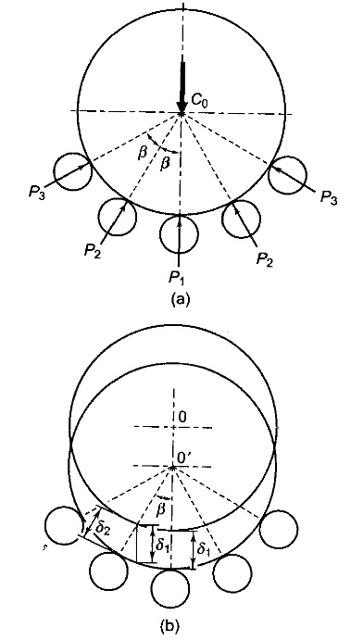
Stribeck’s equation
Stribeck’s equation gives static load capacity of bearing.
The assumptions considered for Stribeck’s equation are:
The races are rigid and retain their circular shape.
The balls are equally spaced.
The balls in the upper half do not support any load.
Fig. 5(a) shows the forces acting on the inner race through
the rolling elements, which support the static load C₀
It is assumed that there is a single row of balls.
Considering the equilibrium of forces in the vertical direction
(1)
Fig. 5: (a) Forces acting on inner race
(b) Deflection of inner race

Slide 26
As the races are rigid, only balls are deformed. Suppose is the deformation at the most heavily stressed Ball No. 1.
Due to this deformation, the inner race is deflected with respect to the outer race through
As shown in Fig. 5(b), the centre of the inner ring moves from O to O¹ through the distance A without changing its shape.
Suppose , ... are radial deflections at the respective balls.
We have, or
According to Hertz’s equation, the relationship between the load and deflection at each ball is given by,
……………….. (2)

Slide 27
Therefore,
and
……………….. (3)
From eq. (2) and eq. (3), we have
……………….. (4)
In a similar way,
……………….. (5)
Substituting the above values in eq. 1, we have

Slide 28
Where
If z is the number of balls,
The values of M for different values of z are
It is seen from the above table that z/M is practically constant.
So, Stribeck suggested the value for z/M as 5 or
Substituting the above value in eq. (6), we have
Z | 8 | 10 | 12 | 15
M (z/M) | 1.84 4.35 | 2.28 4.38 | 2.75 4.36 | 3.47 4.37

Slide 29
………………….. (7)
From experimental evidence, it is found that the force required to produce a permanent deformation of the ball is given by,
………………….. (8)
where, d is the ball diameter and the factor k depends upon the radius of curvature at the point of contact, and on the moduli of elastic of materials.
From eqns. 7 and 8, we have
………………….. (9)
The above equation is known as Stribeck’s equation.

Slide 30
Dynamic load carrying capacity
The life of a ball bearing is limited by the fatigue failure at the surfaces of balls and races. The dynamic load carrying capacity of the bearing is, therefore, based on the fatigue life of the bearing.
The life of an individual ball bearing is defined as the number of revolutions (or hours of service at some given constant speed), which the bearing runs before the first evidence of fatigue crack in balls or races.
Since the life of a single bearing is difficult to predict, it is necessary to define the life in terms of the statistical average performance of a group of bearings.

Slide 31
Bearings are rated on one of the two criteria
average life
rated life
The second criterion is widely used in bearing industry.
The rating life of a group of apparently identical ball bearings is defined as the number of revolutions that 90% of the bearings will complete or exceed before the first evidence of fatigue crack.
There are a number of terms used for this rating life. They are minimum life, catalogue life, L₁₀ or life or B₁₀ life.
The life of an individual ball bearing may be different from rating life.
Statistically, it can be proved that the life, which 50% of a group of bearings will complete or exceed, is approximately five times the rating or L₁₀ life.

Slide 32
Equivalent bearing load
The equivalent dynamic load is defined as the constant radial load in radial bearings (or thrust load in thrust bearings), which if applied to the bearing would give same life as that which the bearing will attain under actual condition of forces.
The expression for the equivalent dynamic load is written as,
……………….. (10)
where,
P= equivalent dynamic load (N)
Fr= radial load (N)
Fa= axial or thrust load (N)
V=race-rotation factor
X and Y are radial and thrust factors respectively and their values are given in manufacturer’s catalogue.
P = XVF_{r}+ YF_{a}

Slide 33
The race-rotation factor (V) depends upon whether the inner race is rotating or the outer race.
The value of V is 1 when the inner race rotates while the outer race is held stationary in the housing.
The value of V is 1.2 when the outer race rotates with respect to the load, while the inner race remains stationary.
In most of the applications, the inner race rotates and the outer race is fixed in the housing.
Assuming ‘V’ as unity, the general equation for equivalent dynamic load is given by,
……………… (11)
The above equation is used for calculating equivalent dynamic load.
P = XF_{r} + YF_{a}

Slide 34
When the bearing is subjected to pure radial load, F_{r}
………………. (12)
When the bearing is subjected to pure thrust load, F_{a}
……………… (13)
P = F_{r}
P = F_{a}

Slide 35
Load-Life Relationship
The relationship between the dynamic load carrying capacity, the equivalent dynamic load, and the bearing life is given by,
…………………… (14)
where = rated bearing life (in million revolutions)
C = dynamic load capacity (N)
P = 3 (for ball bearings)
P = 10/3 (for roller bearings)
Rearranging eq. (14),

Slide 36
The relationship between life in revolutions and life in working hours is given by
……………………. (15)
Where,
is rated bearing life
n is speed of rotation
Selection of bearing life
While selecting the proper size of a bearing, it is necessary to specify the expected life of the bearing for the given application.
The information regarding the life expectancy is generally vague and values based on past experience are used. For all kinds of vehicles, the speed of rotation is not constant and the desired life is expressed in terms of millions of revolutions.

Slide 37
Table 1: Bearing life for wheel application
In other applications, the speed of rotation is relatively constant and the desired life is expressed in terms of hours of service.
Table 2: Bearing life for industrial applications
The values given in the above tables are for general purpose. For a particular application, the designer should consider the past experience, the difficulties faced by the customer in replacing the bearing and the economics of breakdown costs.
Wheel application | Life (million rev)
Automobile cars | 50
Trucks | 100
Trolley cars Rail-road | 500
Cars | 1000
Industrial application | Life (hrs.)
Machines used intermittently such as lifting tackle, hand tools and household appliances | 4000-8000 hrs
Machines used for eight hours of service per day, such as electric motors and gear drives | 12000-20000 hrs
Machines used for continuous operation (24 h per day) such as pumps, compressors and conveyors | 40000-60000 hrs

Slide 38
Load Factor
The forces acting on the bearing are calculated by considering the equilibrium of forces in vertical and horizontal planes.
These elementary equations do not take into consideration the effect of dynamic load.
The forces determined by these equations are multiplied by a load factor to determine the dynamic load carrying capacity of the bearing.
Load factors are used in applications involving gear, chain and belt drives.
In gear drives, there is an additional dynamic load due to inaccuracies of the tooth profile and the elastic deformation of teeth.
In chain and belt drives, the dynamic load is due to vibrations.

Slide 39
Table 3: Values of load factor
The values of the load factor given in the above table are used in the absence of precise analysis of dynamic forces.
Types of drive | Load factor
(A) Gear Drives (i) Rotating machines free from impact like electric motors and turbo-compressors | 1.2 – 1.4
(ii) Reciprocating machines like internal combustion engines and compressors | 1.4 – 1.7
(iii) impact machines like hammer mills | 2.5 – 3.5
(B) Belt drives (i) V-belts | 2.0
(ii) Single-ply leather belt | 3.0
(iii) Double-ply leather belt | 3.5
(C) Chain Drives | 1.5

Slide 40
Selection of bearing from Manufacturer’s catalogue
The procedure for the selection of a bearing from the manufacturer’s catalogue consists of the following steps:
Calculate the radial and axial forces acting on the bearing and determine the diameter of the shaft where the bearing is to be fitted.
Select the type of bearing for the given application.
Determine the values of X and Y, the radial and thrust factors, from the catalogue. The values of X and Y factors for single row deep groove ball bearings are given in Table. 4 below. The values depend upon two ratios, and , where is the static load capacity. The selection of the bearing is, therefore, done by trial and error. The static and dynamic load capacities of single-row deep groove ball bearings of different series are given in Table. 5.

Slide 41
Table 4: X and Y factors for single row deep groove ball bearings
(iv) Calculate the equivalent dynamic load from the equation
(v) Make a decision about the expected bearing life and express the life in million revolutions.
(vi) Calculate the dynamic load capacity from the equation
 | X | Y | X | Y
0.025 | 1 | 0 | 0.56 | 2.0 | 0.22
0.040 | 1 | 0 | 0.56 | 1.8 | 0.24
0.070 | 1 | 0 | 0.56 | 1.6 | 0.27
0.130 | 1 | 0 | 0.56 | 1.4 | 0.31
0.250 | 1 | 0 | 0.56 | 1.2 | 0.37
0.500 | 1 | 0 | 0.56 | 1.0 | 0.44

Slide 42
(vii) Check whether the selected bearing of series 60 has required dynamic capacity. If not select the bearing of the next series and go back to step iii and continue.
Ball bearings are thus selected by the trial and error procedure. The above procedure is also applicable to other types of bearings.
Table. 5: Dimensions and Static and Dynamic load capacities of Single row deep groove ball bearings
Principal Dimensions(mm) |  |  | Basic ratings (N) | Load | Designation
d | D (mm) | B | C | Co
10 | 19 | 5 | 1480 | 630 | 61800
 | 26 | 8 | 4620 | 1960 | 6000
 | 30 | 9 | 5070 | 2240 | 6200
 | 35 | 11 | 8060 | 3750 | 6300
12 | 21 | 5 | 1430 | 695 | 61801
 | 28 | 8 | 5070 | 2240 | 6001
 | 32 | 10 | 6890 | 3100 | 6201
 | 37 | 12 | 9750 | 4650 | 6301

Slide 43
Table 5 contd….
Principal Dimensions(mm) |  |  | Basic ratings (N) | Load | Designation
d | D (mm) | B | C | Co
15 | 24 | 5 | 1560 | 815 | 61802
 | 32 | 9 | 5590 | 2500 | 6002
 | 35 | 11 | 7800 | 3550 | 6202
 | 42 | 13 | 11400 | 5400 | 6302
17 | 26 | 5 | 1680 | 930 | 61803
 | 35 | 10 | 6050 | 2800 | 6003
 | 40 | 12 | 9560 | 4500 | 6202
 | 47 | 14 | 13500 | 6550 | 6303
 | 62 | 17 | 22900 | 11800 | 6403
20 | 32 | 7 | 2700 | 1500 | 61804
 | 42 | 8 | 7020 | 3400 | 16404
 | 42 | 12 | 9360 | 4500 | 6202
 | 47 | 14 | 12700 | 6200 | 6303
 | 52 | 15 | 15900 | 7800 | 6403
 | 72 | 19 | 30700 | 16600 | 6304
25 | 37 | 7 | 3120 | 1960 | 61805
 | 47 | 8 | 7610 | 4000 | 16005
 | 47 | 12 | 11200 | 5600 | 6005
 | 52 | 15 | 14000 | 6950 | 6205
 | 62 | 17 | 22500 | 11400 | 6305
 | 80 | 21 | 35800 | 19600 | 6405

Slide 44
Table 5 contd….
Principal Dimensions(mm) |  |  | Basic ratings (N) | Load | Designation
d | D (mm) | B | C | Co
30 | 42 | 7 | 3120 | 2080 | 61806
 | 55 | 9 | 11200 | 5850 | 16006
 | 55 | 13 | 13300 | 6800 | 6006
 | 62 | 16 | 19500 | 10000 | 6206
 | 72 | 19 | 28100 | 14600 | 6306
 | 90 | 23 | 43600 | 24000 | 6406
35 | 47 | 7 | 4030 | 3000 | 61807
 | 62 | 9 | 12400 | 6950 | 16007
 | 62 | 9 | 12400 | 6950 | 16007
 | 72 | 17 | 25500 | 13700 | 6207
 | 80 | 21 | 33200 | 18000 | 6307
 | 100 | 25 | 55300 | 31000 | 6407
40 | 52 | 7 | 4160 | 3350 | 61808
 | 68 | 9 | 13300 | 7800 | 16008
 | 68 | 15 | 16800 | 9300 | 6008
 | 80 | 18 | 307000 | 16600 | 6208
 | 90 | 23 | 41000 | 22400 | 6308
 | 110 | 27 | 63700 | 36500 | 6408

Slide 45
Table 5 contd….
Principal Dimensions(mm) |  |  | Basic ratings (N) | Load | Designation
d | D (mm) | B | C | Co
70 | 90 | 10 | 12100 | 9150 | 61814
 | 110 | 13 | 28100 | 19000 | 16014
 | 110 | 20 | 37700 | 24500 | 6014
 | 125 | 24 | 61800 | 37500 | 6214
 | 150 | 35 | 104000 | 63000 | 6314
 | 180 | 42 | 143000 | 104000 | 6414
75 | 95 | 10 | 12500 | 9800 | 61815
 | 115 | 13 | 28600 | 20000 | 10615
 | 130 | 25 | 6630 | 40500 | 6215
 | 160 | 37 | 112000 | 72000 | 6315
 | 190 | 45 | 153000 | 14000 | 6415

Slide 46
In order to explain the selection procedure, let us consider a numerical example.
Suppose it is required to select a single-row deep groove ball bearing, for a shaft that is 75 mm in diameter and which rotates at 125 rpm. The bearing is subjected to a radial load of 21 kN and there is no thrust load. The expected life of the bearing is 10 000 hours.
Step (i)
Step (ii) Type: single-row deep groove ball bearing.
Step (iii) Since there is no axial load,
Step (iv)

Slide 47
Step (v)
Step (vi)
It is observed from Table. 5, that following bearings are available with 75 mm bore diameter,
No. 6015 (C = 39 700 N)
No. 6215 (C = 66 300 N)
No. 6315 (C = 112 000 N)
No. 6415 (C = 153 000 N)
Therefore, bearing No. 6315 is selected for the above application.

Slide 48
Series of the bearing
While selecting a ball bearing from the manufacturer's catalogue, very often a term 'series' of the bearing is used. Some manufacturers use terms such as light series, medium series and heavy series.
For a given diameter of the shaft, the dimensions of balls and races are smaller in the light series. The load capacities are less and cost is also less. For the same shaft diameter, the dynamic load carrying capacity of the bearing belonging to the heavy series is more and the cost is also more.
The trial and error method for the selection of a ball bearing begins with the light series. If that is not suitable, a medium series bearing is selected. The last choice is the costliest heavy series bearing.

Slide 49
A rolling contact bearing is usually designated by three or four digits. The meaning of these digits is as follows:
(i) The last two digits indicate the bore diameter of the bearing in mm (bore diameter divided by 5). For example, XX07 indicates a bearing of 35 mm bore diameter.
(ii) The third digit from the right indicates the series of the bearing. The numbers used to indicate the series are as follows:
Extra light series —1
Light series — 2
Medium series — 3
Heavy series — 4
For example, X307 indicates a medium series bearing with a bore diameter of 35 mm.
(iii) The fourth digit and sometimes fifth digit from the right specifies the type of rolling contact bearing. For example, the digit 6 indicates deep groove ball bearings.

Slide 50
Light series bearings permit smallest bearing width and outer diameter for a given bore diameter. They have lowest load carrying capacities.
Medium series bearings have 30 to 40 per cent higher dynamic load carrying capacities compared with light series bearings of the same bore diameter. However, they occupy more radial and axial space. Heavy series bearings have 20 to 30 per cent higher dynamic load carrying capacities compared with medium series bearings of the same bore diameter.
The ISO plan for the dimension series of the bearing is illustrated in Fig. 6(a) below.
It consist of two digit numbers. The first number indicates the width series 8, 0, 1, 2, 3, 4, 5, and 6 in order of increasing width.
The second number indicates the diameter series 7, 8, 9, 0, 1, 2, 3, and 4 in order of ascending outer diameter of the bearing.

Slide 51
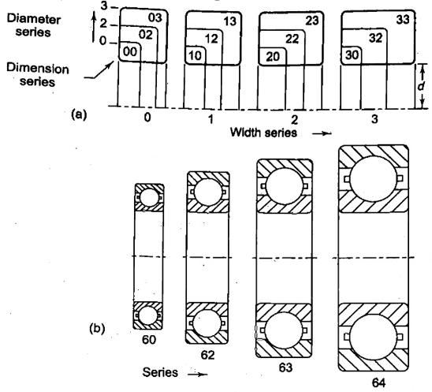
Figure 6(b) shows the proportionate dimensions of SKF bearings belonging to different series with a 50 mm bore diameter (Bearing No. 6010, 6210, 6310 and 6410).
Fig. 6: Dimension series of bearing

